Slide 1
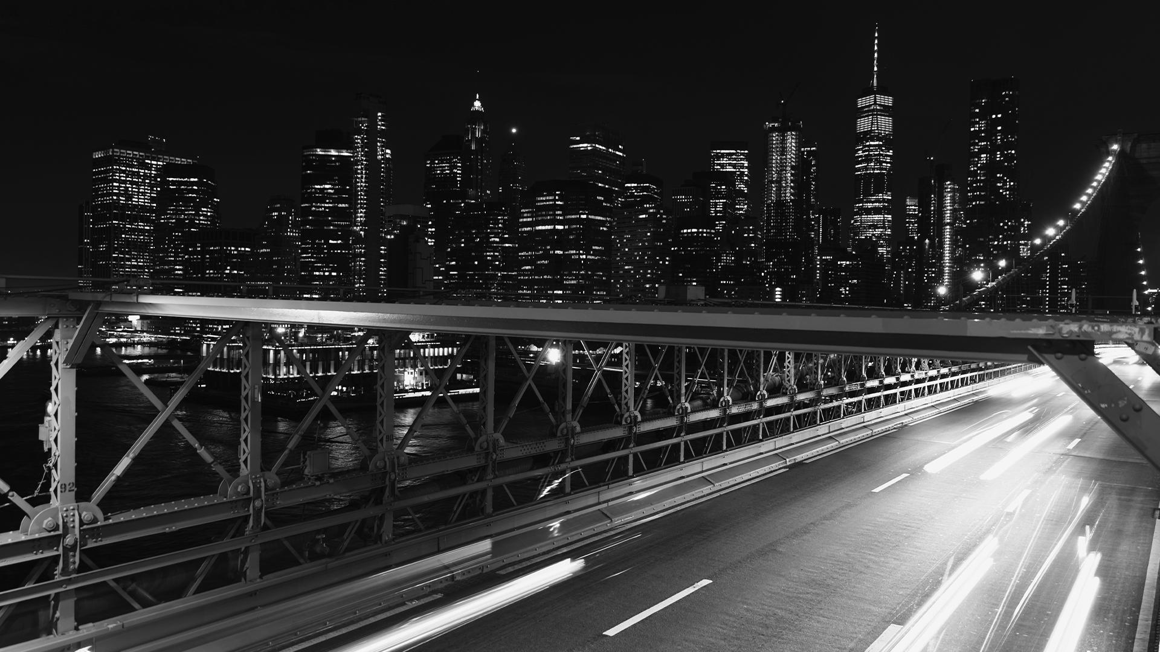

Uber’s Taxi Fares

Slide 2
OUR TEAM
Anugerah Denata Christian M.
Risalatul Mafazah
Gamaliel Situmeang
Rendy Irawan
Indah Dewi Lestari
Project Leader
Data Cleaning & Analysis
Data Cleaning & Analysis
Visualization Specialist
Visualization Specialist

Slide 3
01
Overview
Problem Statement & Root Cause
02
03
Metodologi
04
Recommendation
Here you could describe the topic of the section
Here you could describe the topic of the section
Here you could describe the topic of the section
Here you could describe the topic of the section

Slide 4
Metodologi
Data Visualization
Data Cleaning
Data Analysis
Data Preparation
OVERVIEW
119,863 orders
(2011 – 2014)
Service
Visualization data with Excel and Tableau to make peresentation and dashboard
Typo, blanks of cell, location where in the sea
New York,
USA
The company's core service is its ridesharing platform, which allows passengers to connect with drivers using a smartphone app.
Uber has also expanded into other areas of transportation, including bike-sharing and food delivery.
Analyze cleaned data using tools like Excel and Tableau
Revenue $ 1,413,163
Dataset : Uber Fares Prediction from Kaggle
Company

Slide 5
OVERVIEW
BUSINESS PROBLEM
Data Visualization
Data Cleaning
Service
Visualization data with Excel and Tableau to make peresentation and dashboard
Growth UBER Order
2014 : ▼-4%
Typo, blanks of cell, location where in the sea
The company's core service is its ridesharing platform, which allows passengers to connect with drivers using a smartphone app.
119,863 orders
(2011 – 2014)
New York,
USA
Data Analysis
Data Preparation
Analyze cleaned data using tools like Excel and Tableau
Dataset : Uber Fares Prediction from Kaggle
Growth UBER Revenue
2014 : ▼-2%
Company
Mercury is the closest planet to the Sun and the smallest one in the Solar System—in fact, it’s only a bit larger than the Moon. Contrary to popular belief, the planet’s name has nothing to do with the liquid metal, since Mercury was named after the Roman messenger god

Slide 6
BUSINESS PROBLEM
OVERVIEW
119,863 orders
(2011 – 2014)
How to increase revenue up to 5% in a year by focusing the order?
Service
Growth UBER Revenue
2014 : ▼-2%
New York,
USA
The company's core service is its ridesharing platform, which allows passengers to connect with drivers using a smartphone app.
Uber has also expanded into other areas of transportation, including bike-sharing and food delivery.
Growth UBER Order
2014 : ▼-4%
Revenue $ 1,413,163
Company
OBJECTIVE
Notes:
Based on the trendline data, it appears that, for 4 years the fares for products have been increasing while the number of orders has been decreasing.
Companies can offer discounts or promotions to help increase order volume.

Slide 7
ROOT CAUSE
OBJECTIVE
Order
Season
Date & Time
Location
Fare
Time
Weekends & Weekdays
Monthly
Neighborhood
Fare/Distance
How to increase revenue up to 5% in a year by focusing the order?

Slide 8
OBJECTIVE
Growth UBER Order
2014 : ▼-4%
BUSINESS PROBLEM
How to gradually increase revenue up to 5% in a year by increasing the order?
Growth UBER Revenue
2014 : ▼-2%
Mercury is the closest planet to the Sun and the smallest one in the Solar System—in fact, it’s only a bit larger than the Moon. Contrary to popular belief, the planet’s name has nothing to do with the liquid metal, since Mercury was named after the Roman messenger god

Slide 9
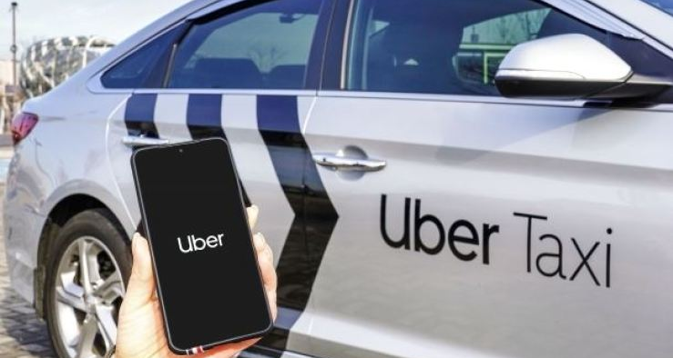
EDA

Slide 10
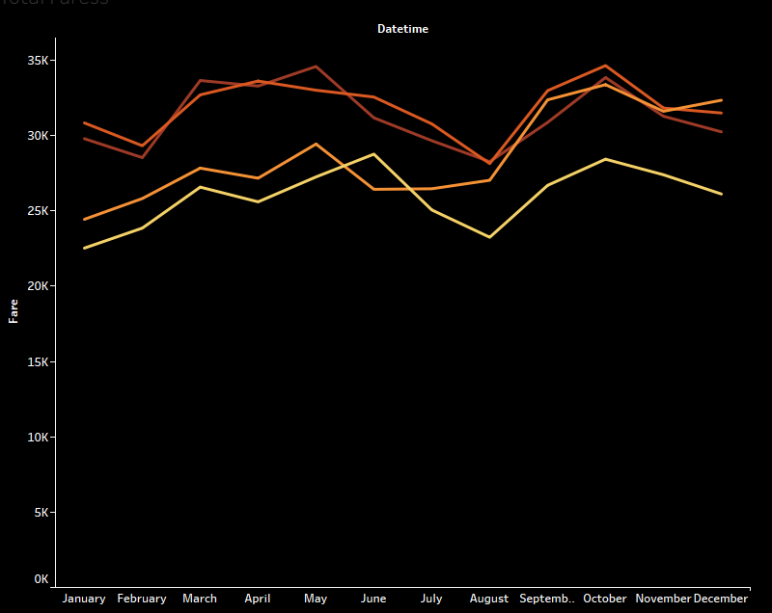
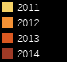
TOTAL REVENUE
$1,413,162.55
(2011 – 2014)
Lowest revenue : August
Highest revenue : October
Notes:
July and August saw a decrease in revenue in 2011, 2013, and 2014, with August generating the lowest total revenue. However, September consistently experienced a significant increase in revenue. Additionally, while quarter 4 saw a decrease in revenue, it still remained higher than that of August

Slide 11
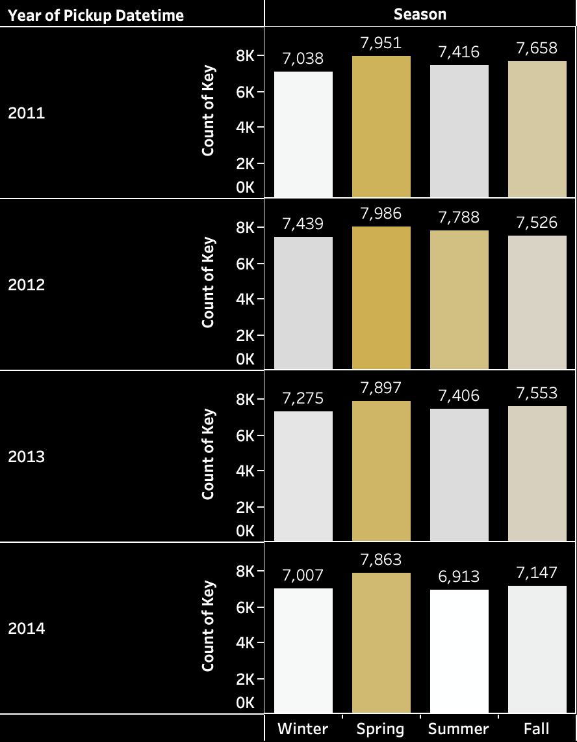
SEASONAL ORDERED
SPRING is the season with the highest number of orders every year, while WINTER has the lowest number of orders over the past three years. In 2014, however, the number of orders during summer was the lowest with a decrease of 950 users

Slide 12
FARE PRICE VS ORDERS
The number of orders has decreased from 2012 to 2014, while the average fare has increased over the same period.
This could suggest that there was a price increase.
The number of orders reached its lowest point in 2014 with only 28,930 orders. This could indicate a decline in demand or increased competition in the market.

Slide 13
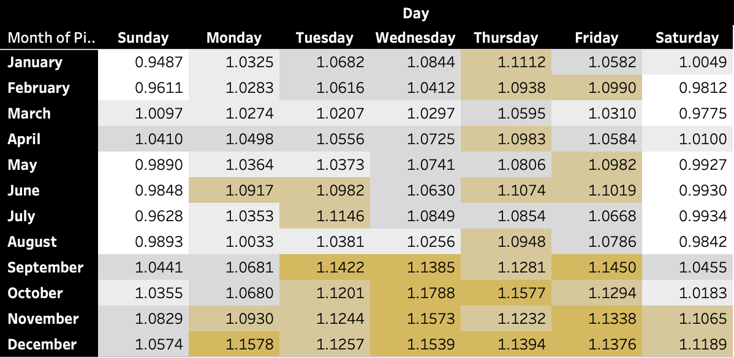
FARES PER DISTANCE
In the months of September through December, the fare per kilometer is considered high, especially on Thursday and Friday.
The highest fare was recorded on Wednesday in October, reaching $1.1788.

Slide 14
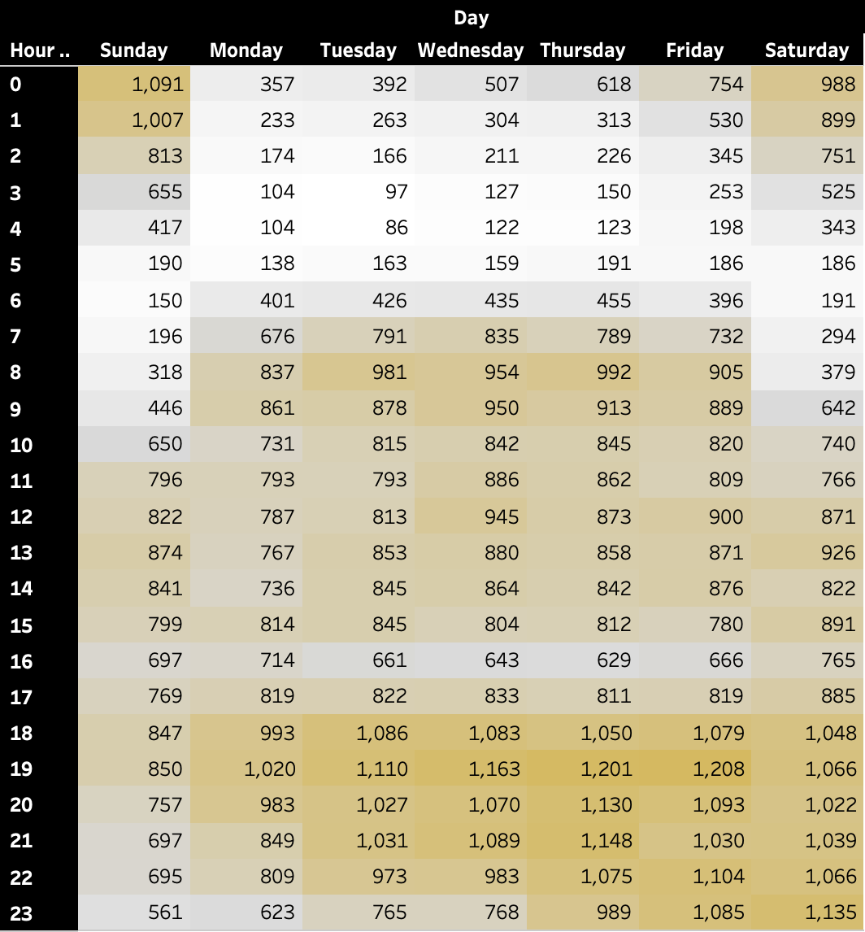
THE BUSIEST TIME
The busiest time in terms of order volume occurs at 7:00 pm, which happens almost every day. Meanwhile, Friday is the day with the highest order volume, with the number of orders being almost the same between 6:00 pm and 11:00 pm. Therefore, the most crowded time for orders is Friday at 7:00 pm

Slide 15
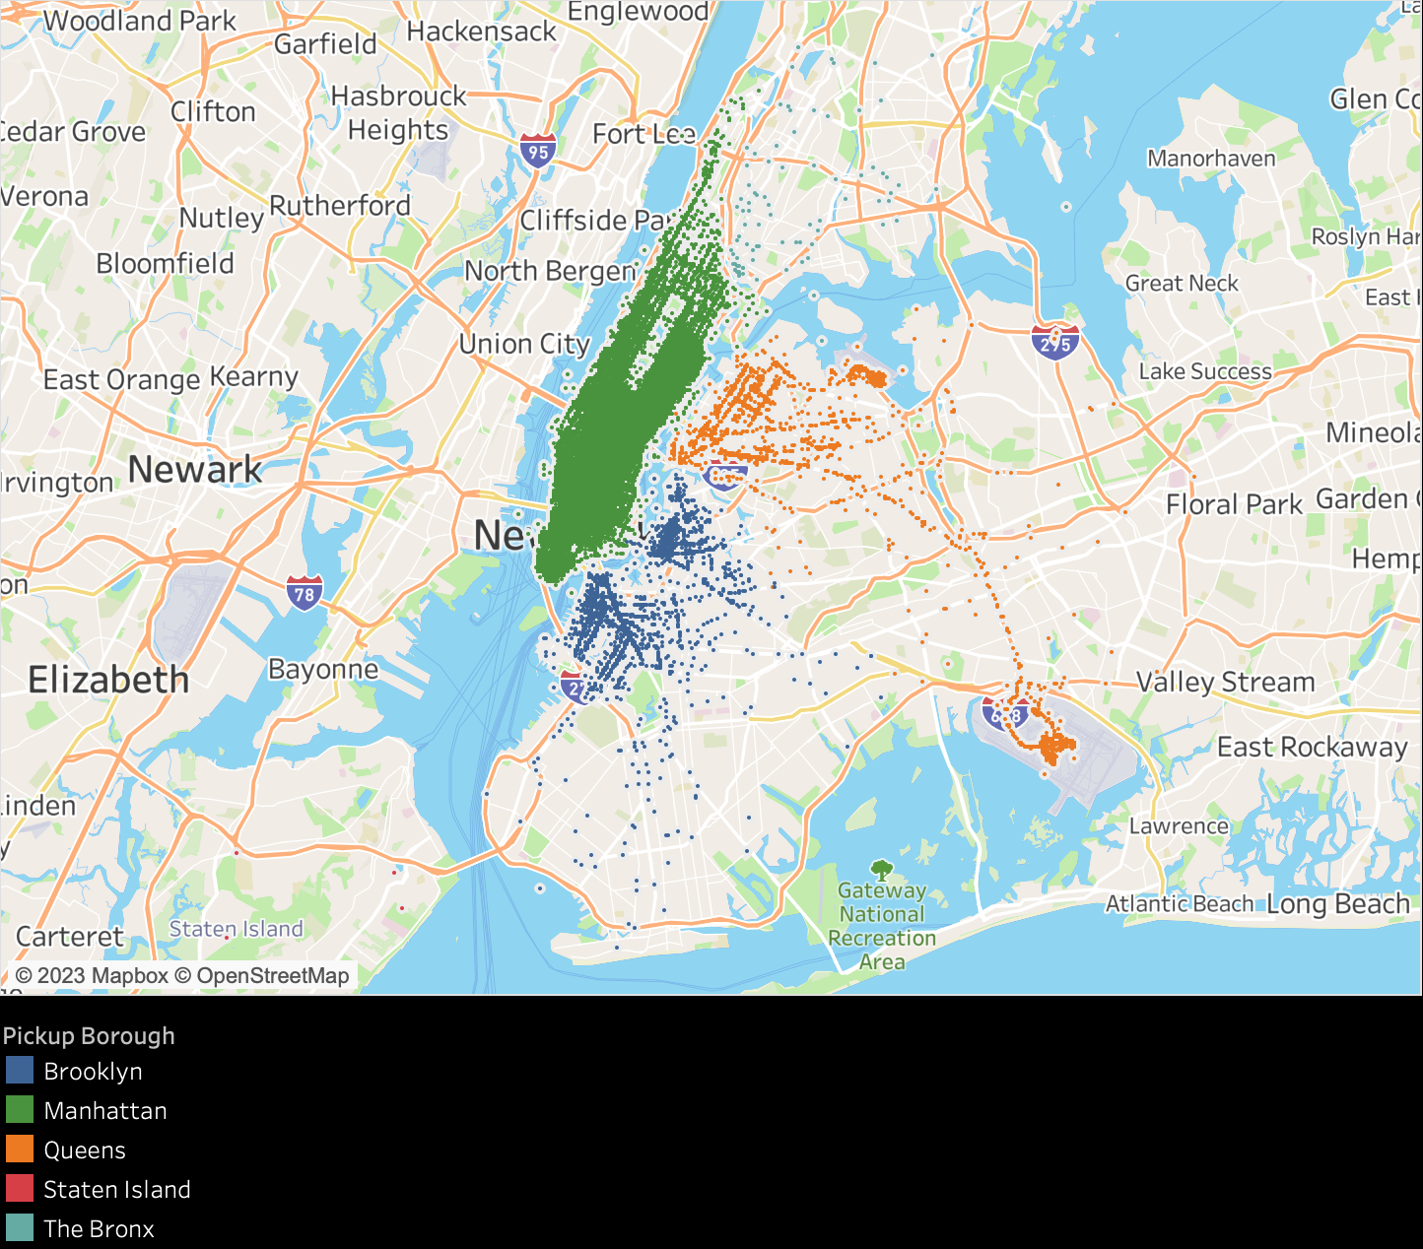
MOST ORDERED PICKUP REGION
Manhattan is the area with the highest number of orders from other areas (Brooklyn, Queens, Staten Island, and The Bronx), with total orders of 111,069 out of 119,863 orders. The most frequent pickup location in Manhattan was Manhattan Community Board 5 with a total of 20,497 orders

Slide 16
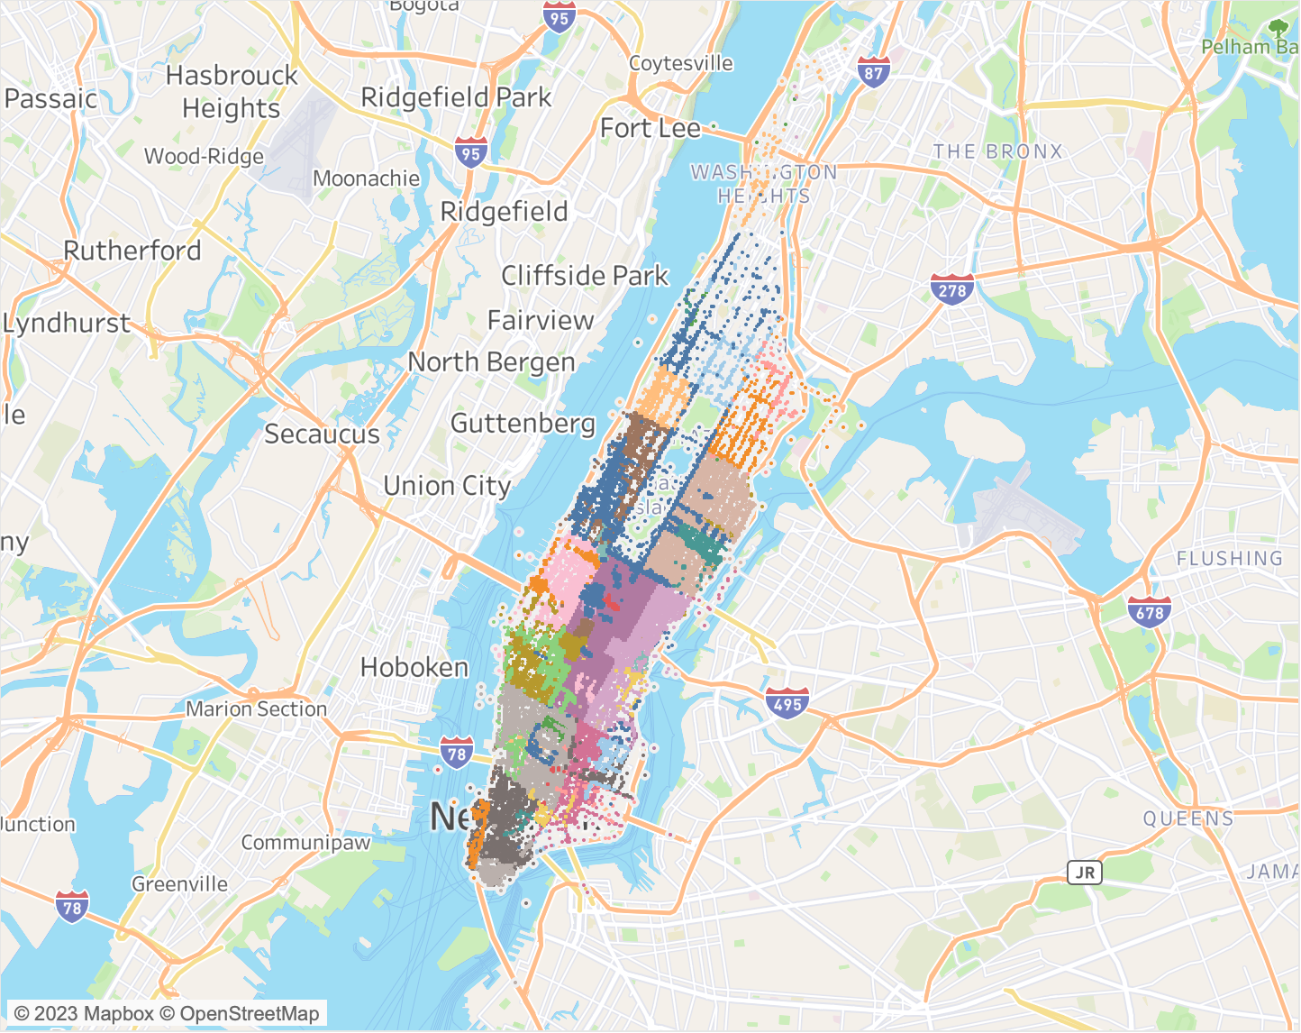
MOST ORDERED PICKUP REGION
Manhattan is the area with the highest number of orders from other areas (Brooklyn, Queens, Staten Island, and The Bronx), with total orders of 111,069 out of 119,500 orders. The most frequent pickup location in Manhattan was Manhattan Community Board 5 with a total of 20,497 orders

Slide 17
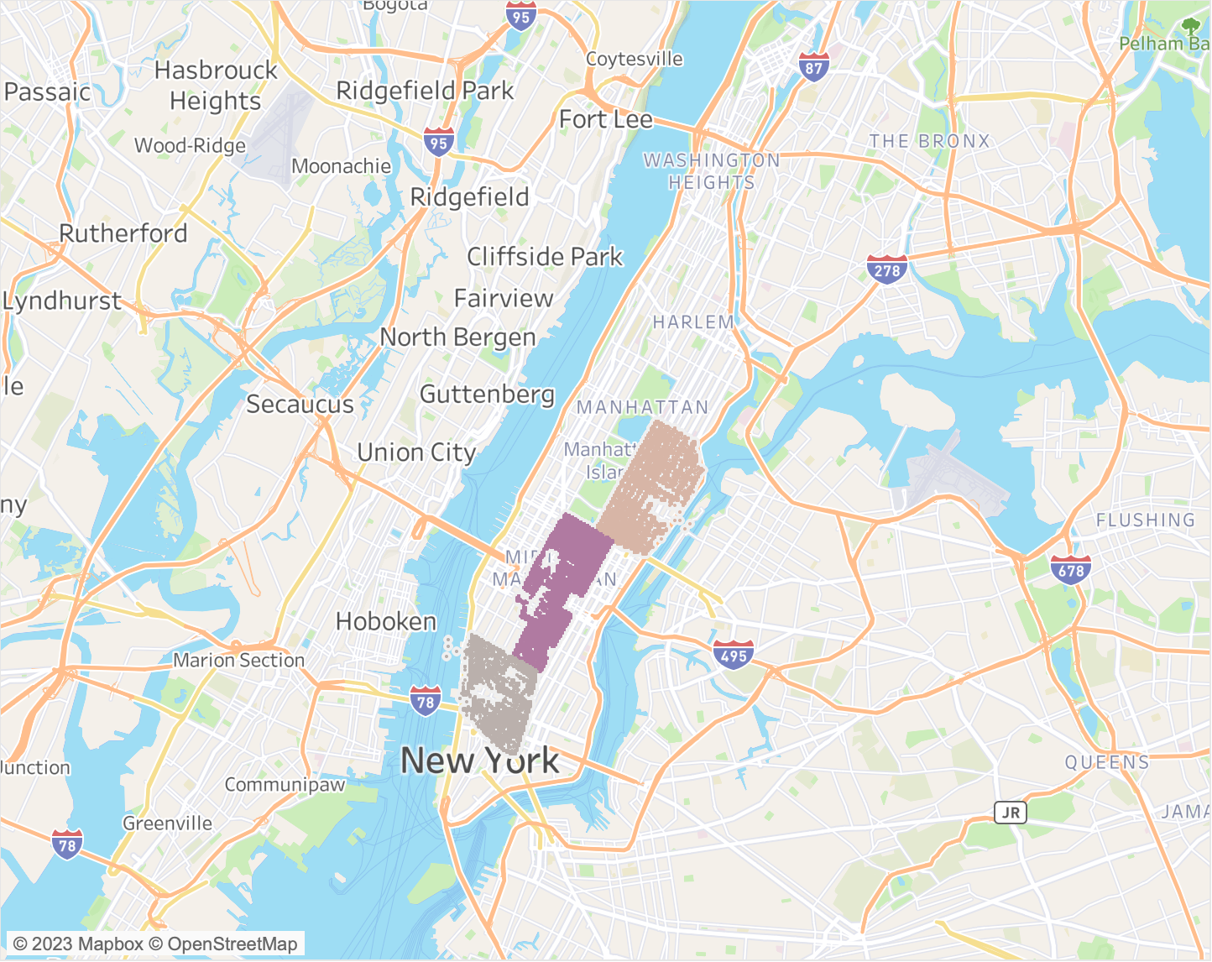
MOST ORDERED PICKUP REGION
Manhattan is the area with the highest number of orders from other areas (Brooklyn, Queens, Staten Island, and The Bronx), with total orders of 111,069 out of 119,500 orders. The most frequent pickup location in Manhattan was Manhattan Community Board 5 with a total of 20,497 orders

Slide 18
CLUSTERING
Cluster | Low Price | Medium Price | High Price
Total Order | 91,801 | 22,764 | 5,298
Range of Fare | $2.5 – 13.5 | $13.7 – 33.5 | $33.7 - 230
Total Revenue | $1,128,317 | $682,966 | $359,415
Distance | 0.9 – 125.7 Km | 0.9 – 92.38 Km | 0.9 – 90.82 Km
The clustering results based on the range of fare and distance are divided into low price, medium price, and high price.

Slide 19
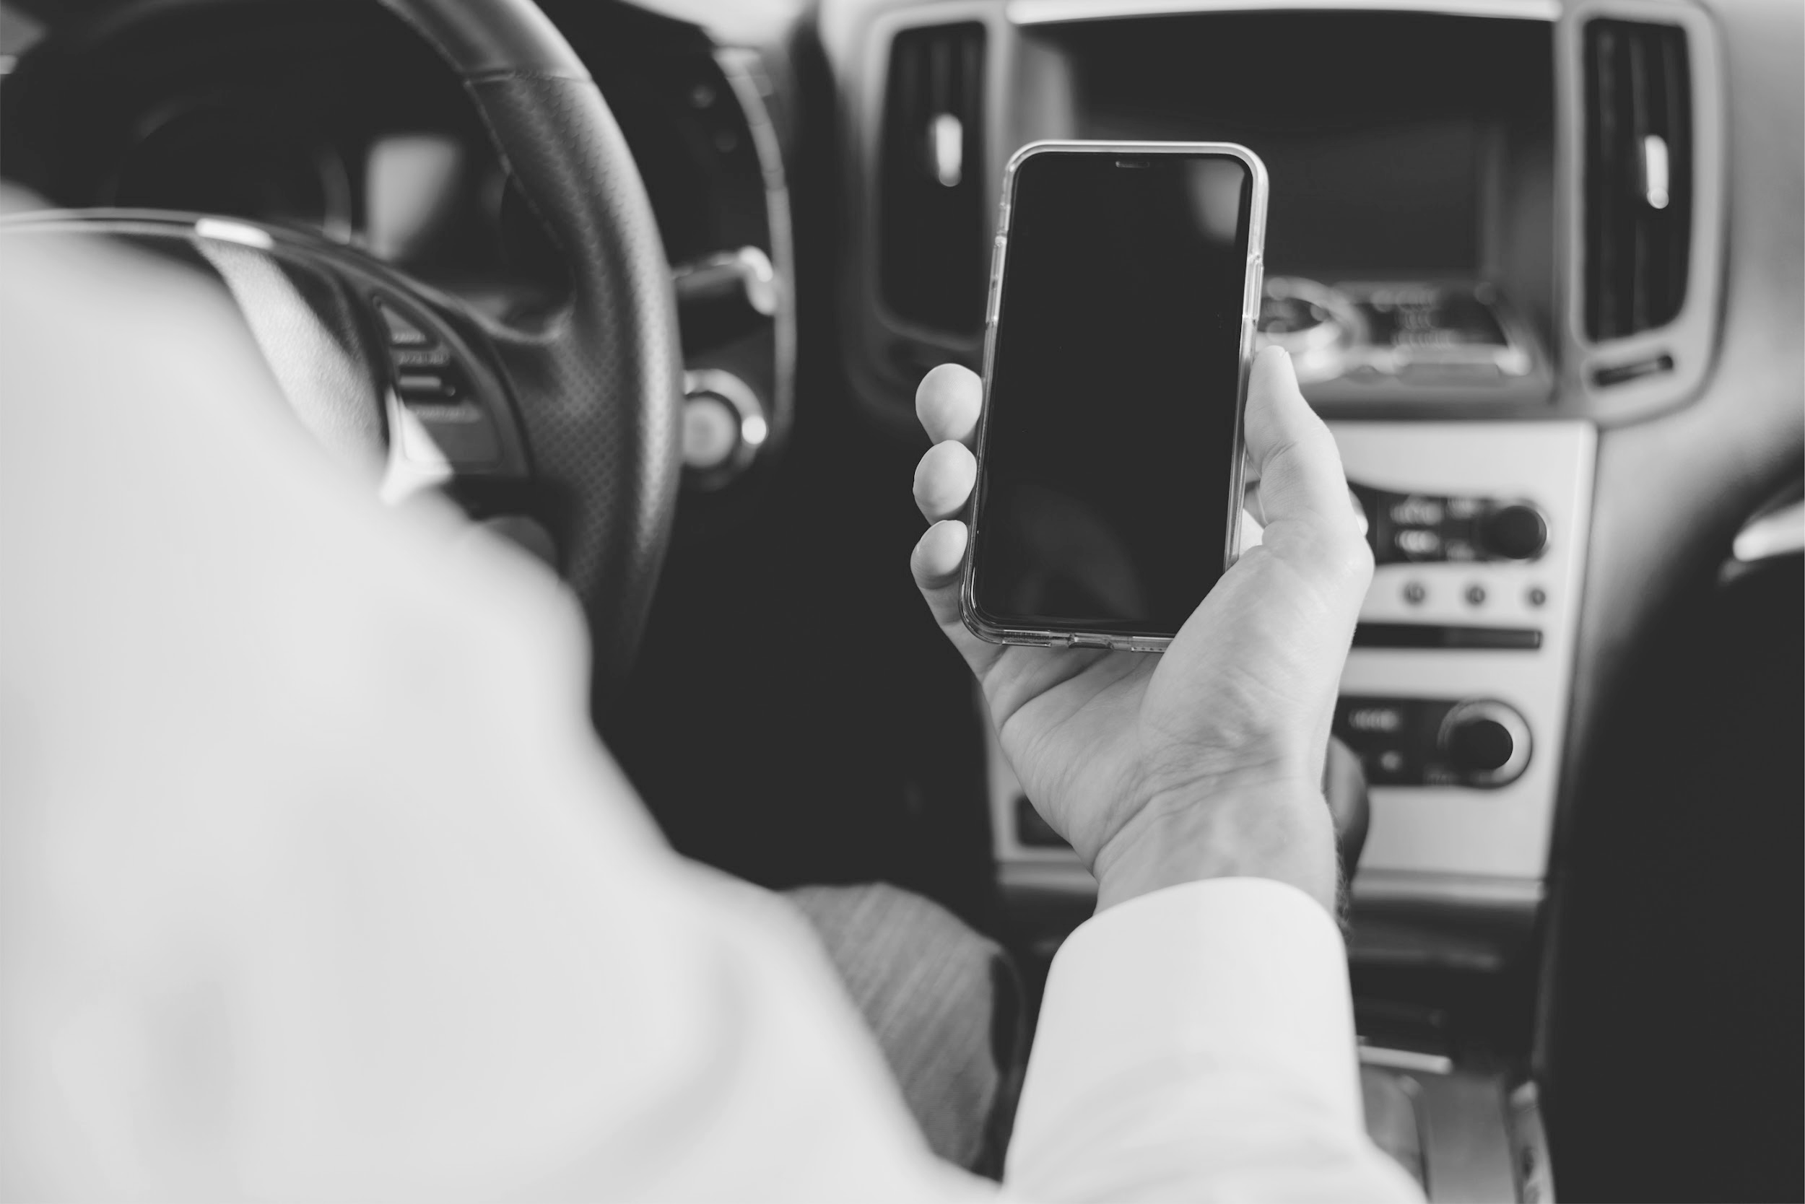
LOCATION
RECOMMENDATION
TIME
Increase promotions during the summer season, especially in beach areas such as Manhattan Beach Park.
Increase promotions in Manhattan, which has the highest order rate, to avoid customer churn and increase company profits.
Offer a 15% voucher for every customer order during weekends from 05.00 am to 09.00 am and on weekdays from 12:00 am to 6:00 am to increase orders.

Slide 20
End of Document.

